Slide 1
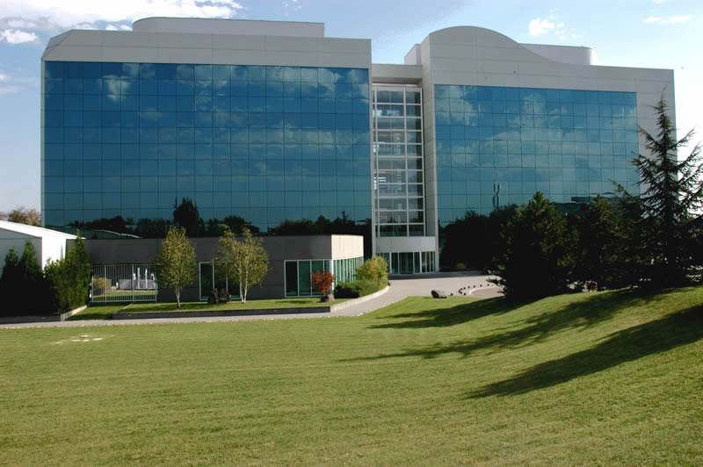






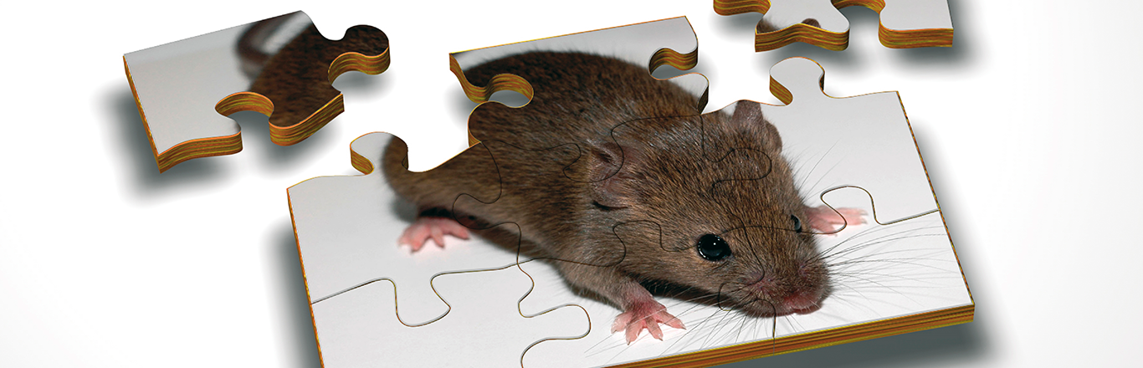
QUACK: ML algorithm to predict new candidate genes involved in {brain dysfunction observed in Down syndrome}:
Based on biological pathway relationships and functional genomics networks case study
QUACK: ML algorithm to predict new candidate genes involved in {topic dysfunction observed in Down syndrome}:
Based on biological pathway relationships and functional genomics networks case study
Mar Muñiz Moreno
Yann Herault
Team Physiopathology of aneuploidy, gene dosage effect and Down syndrome
Herault lab.
Translational Medicine and Neurogenetics Department
I.G.B.M.C.

Slide 2
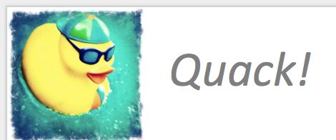

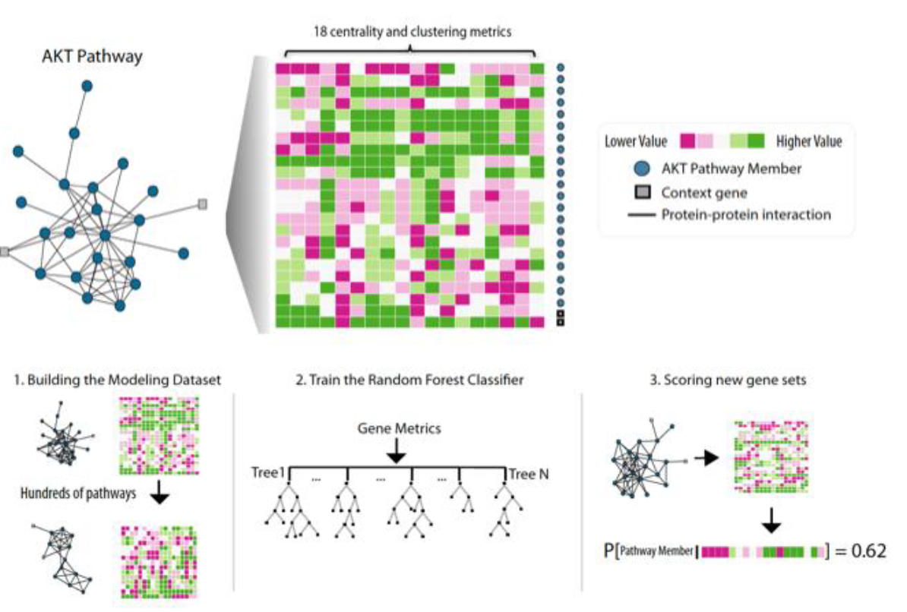
Input files:
DEGs per model
All DEGs together (7 models)
All GAGE synaptic related genes
All STRING04 network nodes
IMPC data?
QUACK
Known genes
Pathways/Genes hash
Network
Query GAGE
KEGG/GOs pathways
Object: hash
Known genes
How it works?
Neuro pathways : 30 min
All pathways : ~12 h
StringDB
Seeds:
DEGs involved in
synaptic pathways
+ Hsa21 Genes
Predicted Genes
Notes:
18 topological properties :
1. Eigenvector Centrality in the Pathway
2. Weighted Degree in the Network
3. Weighted Degree in the Pathway
4. Ratio of the Weighted Degree in the Pathway to that of the Network
5. Ratio of the Pathway Degree to that of the Network
6. Eigenvector Centrality in the Network
7. Closeness Centrality in the Pathway
8. Ratio of the Pathway Eigenvector Centrality to that of the Network
9. Ratio of the Pathway Closeness Centrality to that of the Network
10. Local Clustering Coefficient in the Network
11. Degree in the Network
12. Betweenness Centrality in the Network
13. Closeness Centrality in the Network
14. Betweenness Centrality in the Pathway
15. Degree in the Pathway
16. Local Clustering Coefficient in the Pathway
17. Ratio of the Pathway Local Clustering Coefficient to that of the Network
18. Ratio of the Pathway Betweenness Centrality to that of the Network
http://lagelab.org+
Building a general classifier to predict pathway membership from networks. a) For a given pathway, we measure its topological properties exemplified here with the 21 genes of the AKT pathway in the InWeb protein-protein interaction network. In the matrix, the 18 topological properties are shown as columns and the corresponding values for each of the 21 genes in the AKT pathway (black circles) as rows (metric values correspond to colors as indicated in the figure legend). One row in this matrix corresponds to one row in the final modeling dataset. We make the same measurements for genes in the context of the AKT pathway (white squares); only 2 of 2,449 context genes shown in the illustration. b) This procedure is repeated for 853 pathways from which the modeling dataset used to train the classifier is derived. For any candidate gene in a network, the classifier can assign a probability that it belongs to a pathway (e.g., the AKT pathway) as defined by the candidates topological properties in the overall network and in relation to a specific set of genes (e.g., the 21 AKT genes).

Slide 3
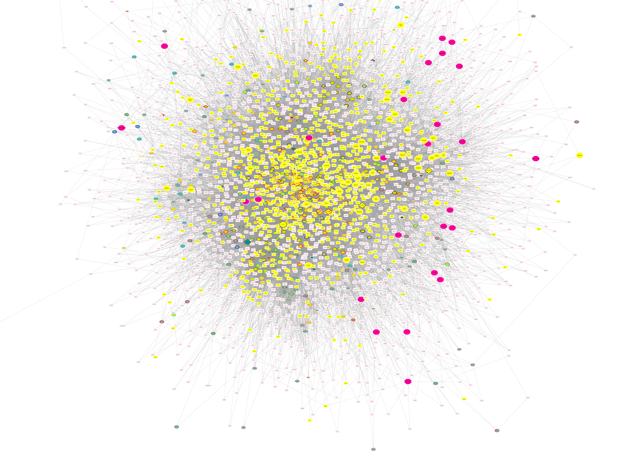

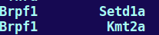
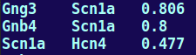
How to run it:
Create the interactions file:
ProtA \n Prot B
Cluster
Query STRING using STRING API to get the interaction scores.
Bash/Py2.7
.graphml
RunPy.sh -mem=40GB -cpus=16
2) stringInteractionsQuery.py (PYTHON2.7)
Use the QUACK algorithm
makeGraphs()
Quack compatible graph file
usr_network_file
usr_modeling_file
quack_gene_model
2. trainModel()
Trains the model using the user network and pathways
usr_pathway_hash_file
Neuro pathways : 30 min
All pathways : ~12 h
Predicted Candidate Genes
3. quackPrediction()
Predict potential candidate genes based on user input genes.
usr_seed_file
Notes:
1.From the network : upload in R the graphml file, using igraph. Then we get a A:B file with the 2 proteins interacting in 2 columns : Script create interactions file with the interaction score: Networks_quackAlgorithms.
Then to add the Interaction score between both proteins we use STRING API and 2 scripts the RunPy.sh and stringInteractionsQuery.py.
2.From R to create the pathway hash querying GAGE, : Script Networks_quackAlgorithms.R
3. Seed file: user list of 1 column gene names
To run Quack once that we have all the input files, script: GeNet_Quack_cluster.R
Wd=

Slide 4
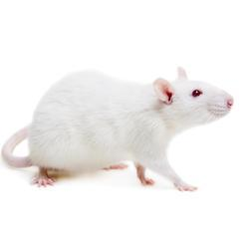
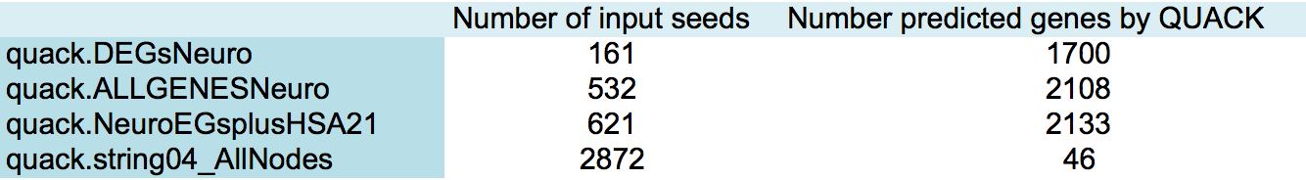

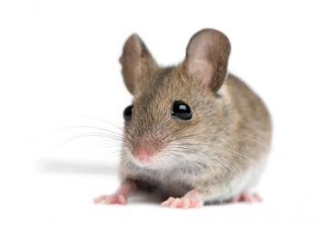
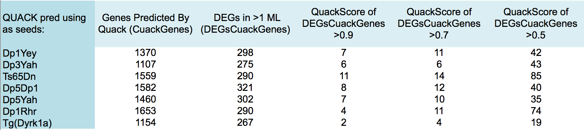
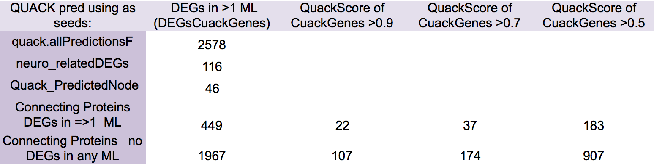
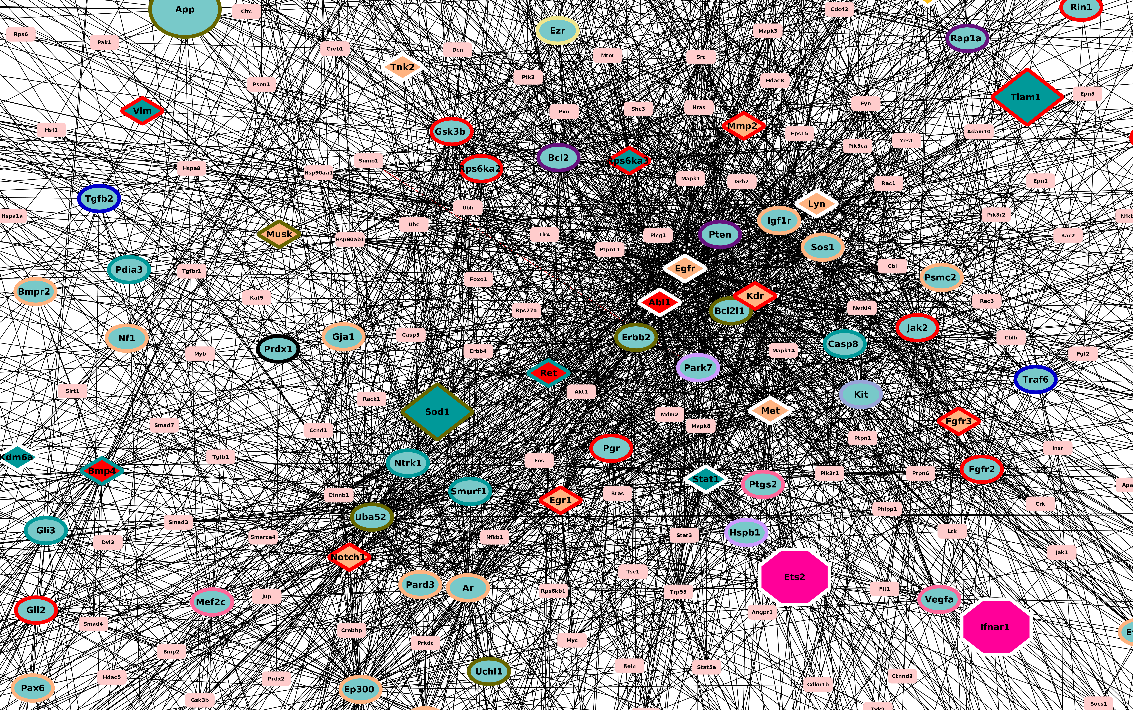
Results:
Input file
RNO11
RNO20
p12
q21.1
q21.2
q21.3
q22.11
q22.2
q22.3
chr21
MMU16
MMU17
MMU10
Lipi
App
Zbtb21
Cbs
Pdxk
Prmt2
Dyrk1a
All results together, merge of the predictions done for each seed file
Notes:
Seeds list
2) Pathway
Network nodes Interaction scores list
Cluster location of files /shared/misc/data5/herault_eq/munizmom/StringQueries
shared between all ML except Dp3Yah
Reduce(intersect, list(a,b,d,e,f,g))
[1] "Calb1" "Chrm2" "Cx3cr1" "Dicer1" "Gata1" "Gnb4" "Hdac3" "Hspb1"
[9] "Maoa" "Pitx3" "Plek" "Rap1b" "Scfd1" "Tk2" "Vamp7" "Vegfa"

Slide 5
Conclusions:
After the multiple testing corrected DEA, reconsider discharged genes that may have being discarged by typeII error if they were predicted by QUACK with a high score
Strengthen the DEA by emphasising the relevance of the DEGs predicted by Quack
Identify new candidate genes that were connecting nodes on the network previously unknown to be linked to these phenotypes so not included in the KEGG/GO terms YET
Identify novel candidates genes whose knockouts generation could be prioritized as their impact in specific phenotypes may be strong based on the QUACK prediction
THANKS!
Further discussion?
Notes:
Further discussion?
identify which new candidates genes knockout generation could be prioritized as their impact in specific phenotypes is assessed based on the use of genomic data and functional networks.

